Slide 1
Sprint 3 Demo
1095-B TAX DOCUMENT
Tuesday, March 8th, 2022

Slide 2















Get to know the team
Core team
Executive team
PRODUCT
ENGINEERING
Ashley Castillo Washington DC Product Manager Lead
Munish Sikka
Washington DC
Product Manager Lead (Incoming)
Jordan White Dallas, TX Product Manager
Tami Corson
North Carolina
Scrum Master
Nadya Primak Washington DC Engineer
Teagan Stephenson Ft. Lauderdale, FL Backend Engineer
Jeff Scheire
MO Studio
Marcy Jacobs
McKinsey
Kevin London Frog
DESIGN
Kit Casey Boston, MA Design Director
Carl Dickerson Atlanta, GA Content Strategist and Plain Language Content Creator
Grace Hong New Jersey Experience
Designer
James Lewis Austin, TX Accessibility and
UX Research Lead
Will Reynolds SERVE
Ben Morris
Pluribus
03-08 Sprint 3 Demo
Introduction

Slide 3



At the end of each sprint on Tuesdays, the team will run sprint reviews to showcase the sprint’s work for approval. The purpose of this meeting is:
WELCOME TO THE SPRINT 3 DEMO
1
To demo the accomplishments or functionality that was built over the past sprint
2
To get feedback and insights early and often
3
To create transparency for anyone interested on the product and progress
03-08 Sprint 3 Demo
Introduction

Slide 4
Roadmap overview
We are here
PHASE
CY 2021
CY 2022
SPRINT
0
1
2
3
4
5
6
7
8
9
10
11
12
13
14
15
16
17
18
19
20
21
22
23
24
25
MONTH
Sep
Oct
Nov
Dec
Jan
Feb
Mar
Apr
May
Jun
Jul
Aug
FOCUS
DHM - Health Apartment
1095-B Form
TBD
03-08 Sprint 3 Demo
Introduction

Slide 5
1095-B Overview
SPRINT 3 DEMO

Slide 6
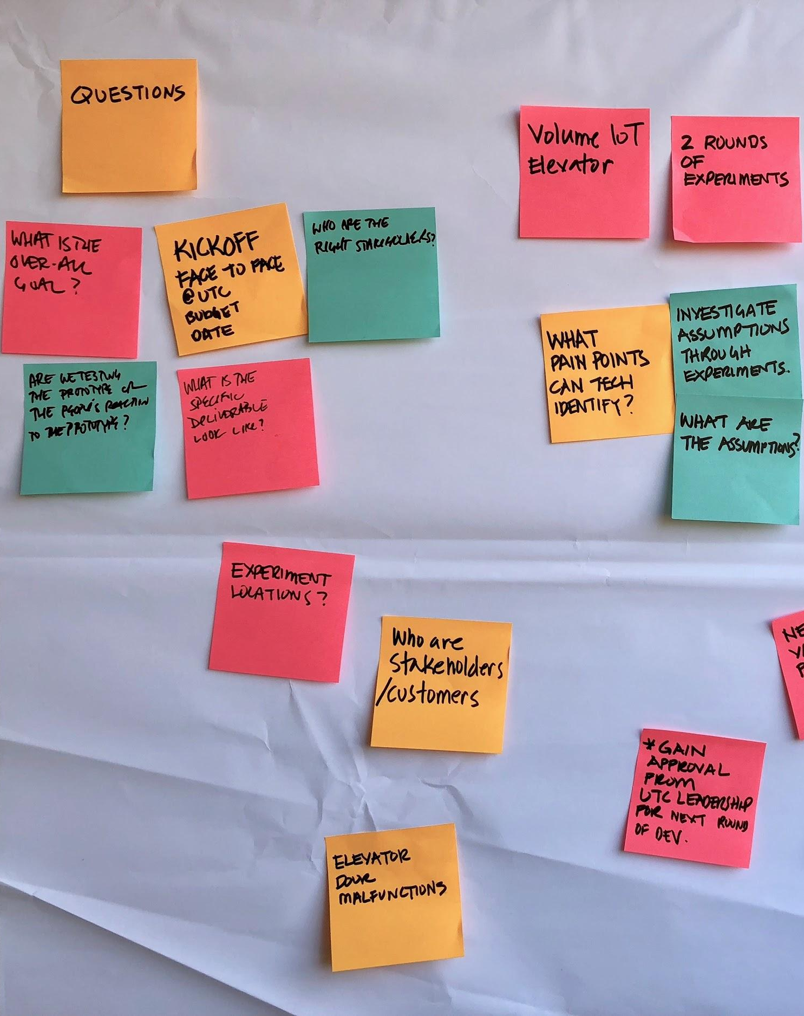
Project objectives
OVERVIEW
Digitize 1095-B form on VA.gov so Veterans can easily access the form and download the form for their records.
Goal: April 1st MVP launch
03-08 Sprint 3 Demo
Overview

Slide 7




1095-B Project status & workplan
Owned by design team
Owned by product/ engineering team
Release
WE ARE HERE
SPRINT 0
SPRINT 1
SPRINT 2
SPRINT 3
SPRINT 4
SPRINT 5
Week 1: 01/20 – 01/26
Week 2: 01/26–02/02
Week 3: 02/02 – 02/09
Week 4: 02/09 – 02/16
Week 5: 02/16 – 02/23
Week 6: 02/23 – 03/02
Week 7: 03/02- 03/09
Week 8: 03/09 – 03/16
Week 9: 03/16 – 03/23
Week 10: 03/23 – 03/30
Product & Delivery
Build backlog
Identify Change Management or Communications Plan
Handover plan - Prepare for launch
PIV Onboarding
Prioritized backlog
Immersion & onboarding
Legal Review
User Experience & Design
Immersion & onboarding
Testing prep
Testing prep & recruiting
Create post-MVP design refinements
Voice of Veteran
Voice of Veteran
PIV Onboarding
Wireframes & Design
Design iterations
Design iterations
Design QA
User flows
Engineering & Development
Create tech discovery plan
Data discovery
POC for data flow
Build solution (form UI, data connections, storage, etc.)
UAT with Call Center
Immersion & onboarding
Define data flows - Systems mapping
UAT
Test & Refine
Collaboration Cycle
Kickoff
Midpoint Review
Analytics Review
Privacy & Security review
Research Plan Review
Design Intent
Research Plan Review #2 (wireframes)
Staging Review
MVP Launch
Content & IA Review
Contact Center Review
*Does not show post-MVP Validate phase meetings in Collaboration Cycle, such as Full Accessibility Audit and Post-Launch Check In; Contact Center Review adjusted to 3 weeks before launch as approved by Jason Woodman
03-08 Sprint 3 Demo
Overview

Slide 8
Sprint 3
SPRINT 3 DEMO

Slide 9
Agenda
Sprint Goal: For sprint 3 we focused on beginning to build out the PDF generation on the front end and backend and conducted a second round of testing
Run second round of user testing and synthesize findings
Update prototype based on feedback and finalize content for landing page
Proposal of where 1095-B will live
1
DESIGN
2
TECH
Front end build: Logging in, understanding the form, and downloading the form
Backend build: POCs of data controller and script
3
PRODUCT
Start the product guide and product video for the Contact Center review
Identify if generated PDF is accessible
Align on Opt-In path forward
 | We welcome all feedback! Feedback will be collectively reviewed and prioritized appropriately based on where it stacks against other stories in the backlog as well as technical feasibility.
03-08 Sprint 3 Demo
Agenda

Slide 10
1
DESIGN
To validate our vision for the product, we spoke to 8 Veterans in this final round of testing
User Story: Run second round of user testing and synthesize
8 30-minute research sessions with Veterans completed,
12 scheduled: 8 completed, 3 cancelled, 1 no show
2 Parts of the session included:
10-minute interview, 20-minute usability test with prototype of proposed solution
Research goals
Better understand how Veterans might find, use, and edit a digital copy of the 1095b form
Discover needs, pain points and preferences for physical or digital delivery of the form
Test usability of proposed solution
Research notes and synthesis
03-08 Sprint 3 Demo
Design
10

Slide 11
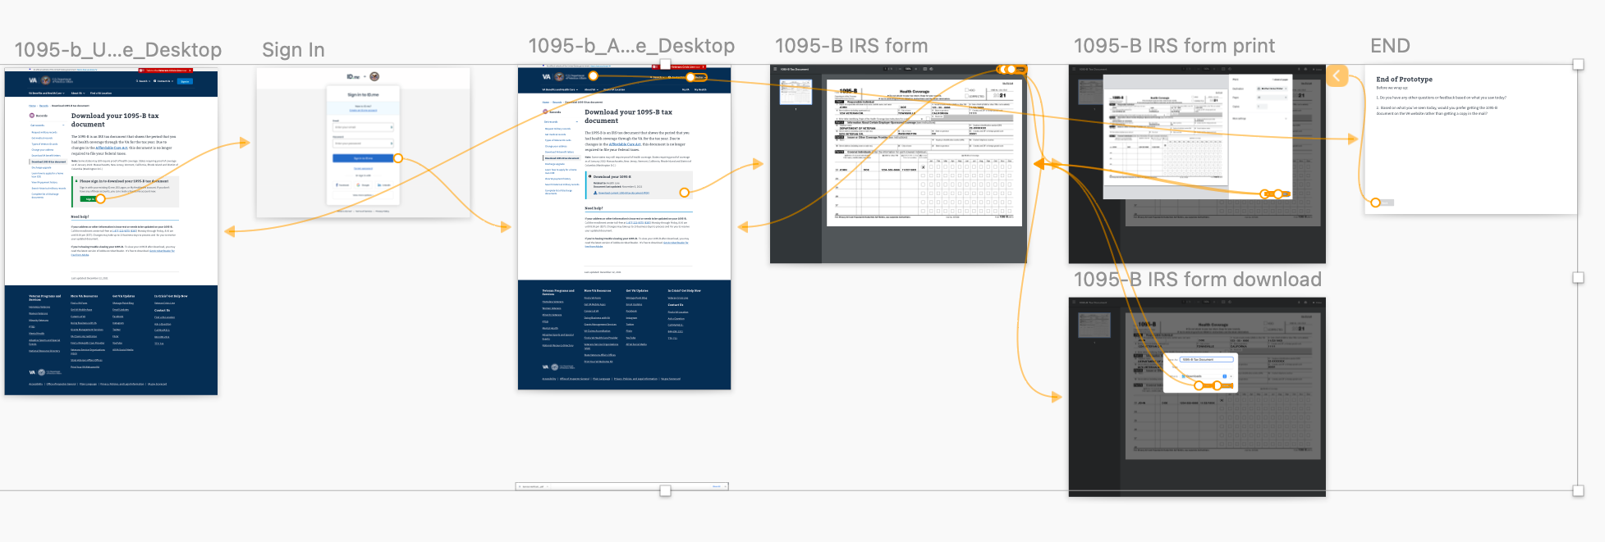
1
DESIGN
We conducted “think aloud” evaluative testing with a high fidelity prototype
03-08 Sprint 3 Demo
Design
11

Slide 12
1
DESIGN
High Level Findings
8/8 Participants successfully completed the task (Sign in, View 1095-B Form, then Download or Print)
7/8 Participants would prefer updating incorrect information on the website rather than calling the enrollment line
6/7 * Participants thought the 1095-B landing page made sense as part of the Records section of the VA website.
* due to the participant being late to the session, we didn’t get to ask this question
6/8 Participants would prefer receiving the 1095-B form on the VA website rather than getting a paper copy in the mail.
1/8 would prefer both, 1/8 would prefer paper
All participants lived in states that don’t require proof of health care to file State taxes
03-08 Sprint 3 Demo
Design
12

Slide 13
1
DESIGN
Research Theme: Do I need this?
During the initial interview, we spoke to participants about their understanding of the 1095-B tax form and how they used it when filing their taxes. When asked “Do you know if the 1095-B form is required when you’re filing taxes?” we saw the same theme of confusion over requirements that we saw in the first round of testing.
1 Participant thought it was a requirement to include the form when filing taxes
2 Participants were unsure if it was required, but reported including it with their taxes last year
3 Participants thought it was unneeded to include in tax filing, but kept it for their records
1 Participant reported shredding it because they didn’t need it
1 Participant wasn’t familiar with the form and didn’t recall ever receiving it in the mail
03-08 Sprint 3 Demo
Design
13

Slide 14
1
DESIGN
Research Theme: Do I need this?
“I don't really need it…[but] I filed it with my income tax paperwork. I don't know that anybody really needs it. Because there doesn't seem to be a lot of follow up with the IRS.”
– Participant 11
03-08 Sprint 3 Demo
Design
14

Slide 15
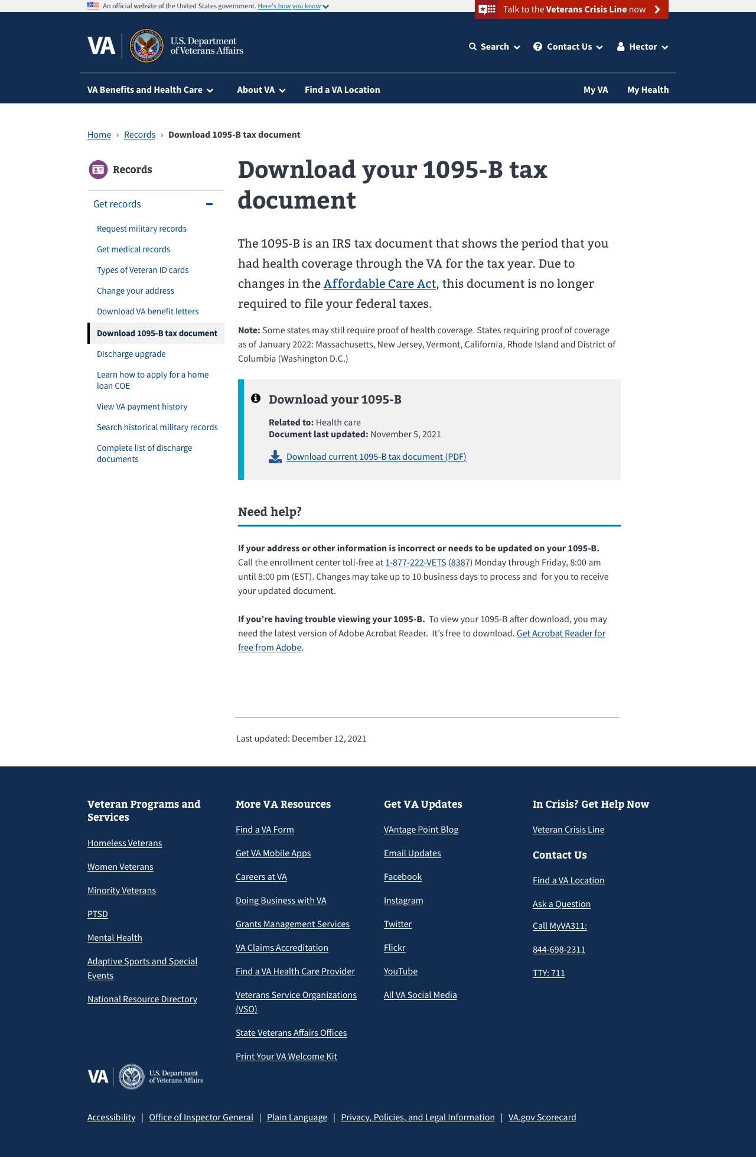
1
DESIGN
Research Theme: Do I need this?
After completing the task with the prototype, and seeing copy regarding 1095-B requirements, one participant asked:
"It says due to changes to the Affordable Care Act, this document is no longer required to file your federal taxes. So why do they still send it out? Because it’s no longer required."
– Participant 3
03-08 Sprint 3 Demo
Design
15

Slide 16
1
DESIGN
Research Theme: Fixing the Form
6/8 Participants found the Help sections and said they would call the enrollment phone number to fix any mistakes on the form.
However, 3/8 Participants would first try selecting “Change Your Address” before calling the enrollment center.
03-08 Sprint 3 Demo
Design
16

Slide 17
1
DESIGN
Research Theme: Fixing the Form
7/8 Participants said they would prefer to correct any mistakes on the form digitally, either by filling in a form or sending a secure message.
Some reasons being:
“[With an online form] I could get a digital receipt” -P4
“I prefer secure messaging if someone got back to you to confirm it was changed.” – P1
The remaining participant preferred the phone or visiting the VA in person so “I don’t have to worry about making a mistake.” This participant was elderly, rarely used their computer and still filed their taxes using paper forms.
03-08 Sprint 3 Demo
Design
17

Slide 18
1
DESIGN
Recommendations
Design is strong and ready to launch
Add additional content on “Change Your Address” landing page directing user to call enrollment center, should they follow that path to update the form
Consider adding online form on authenticated 1095-B page to easily update address or other incorrect information, preventing the user from following other paths or making a phone call (Post MVP).
03-08 Sprint 3 Demo
Design
18

Slide 19
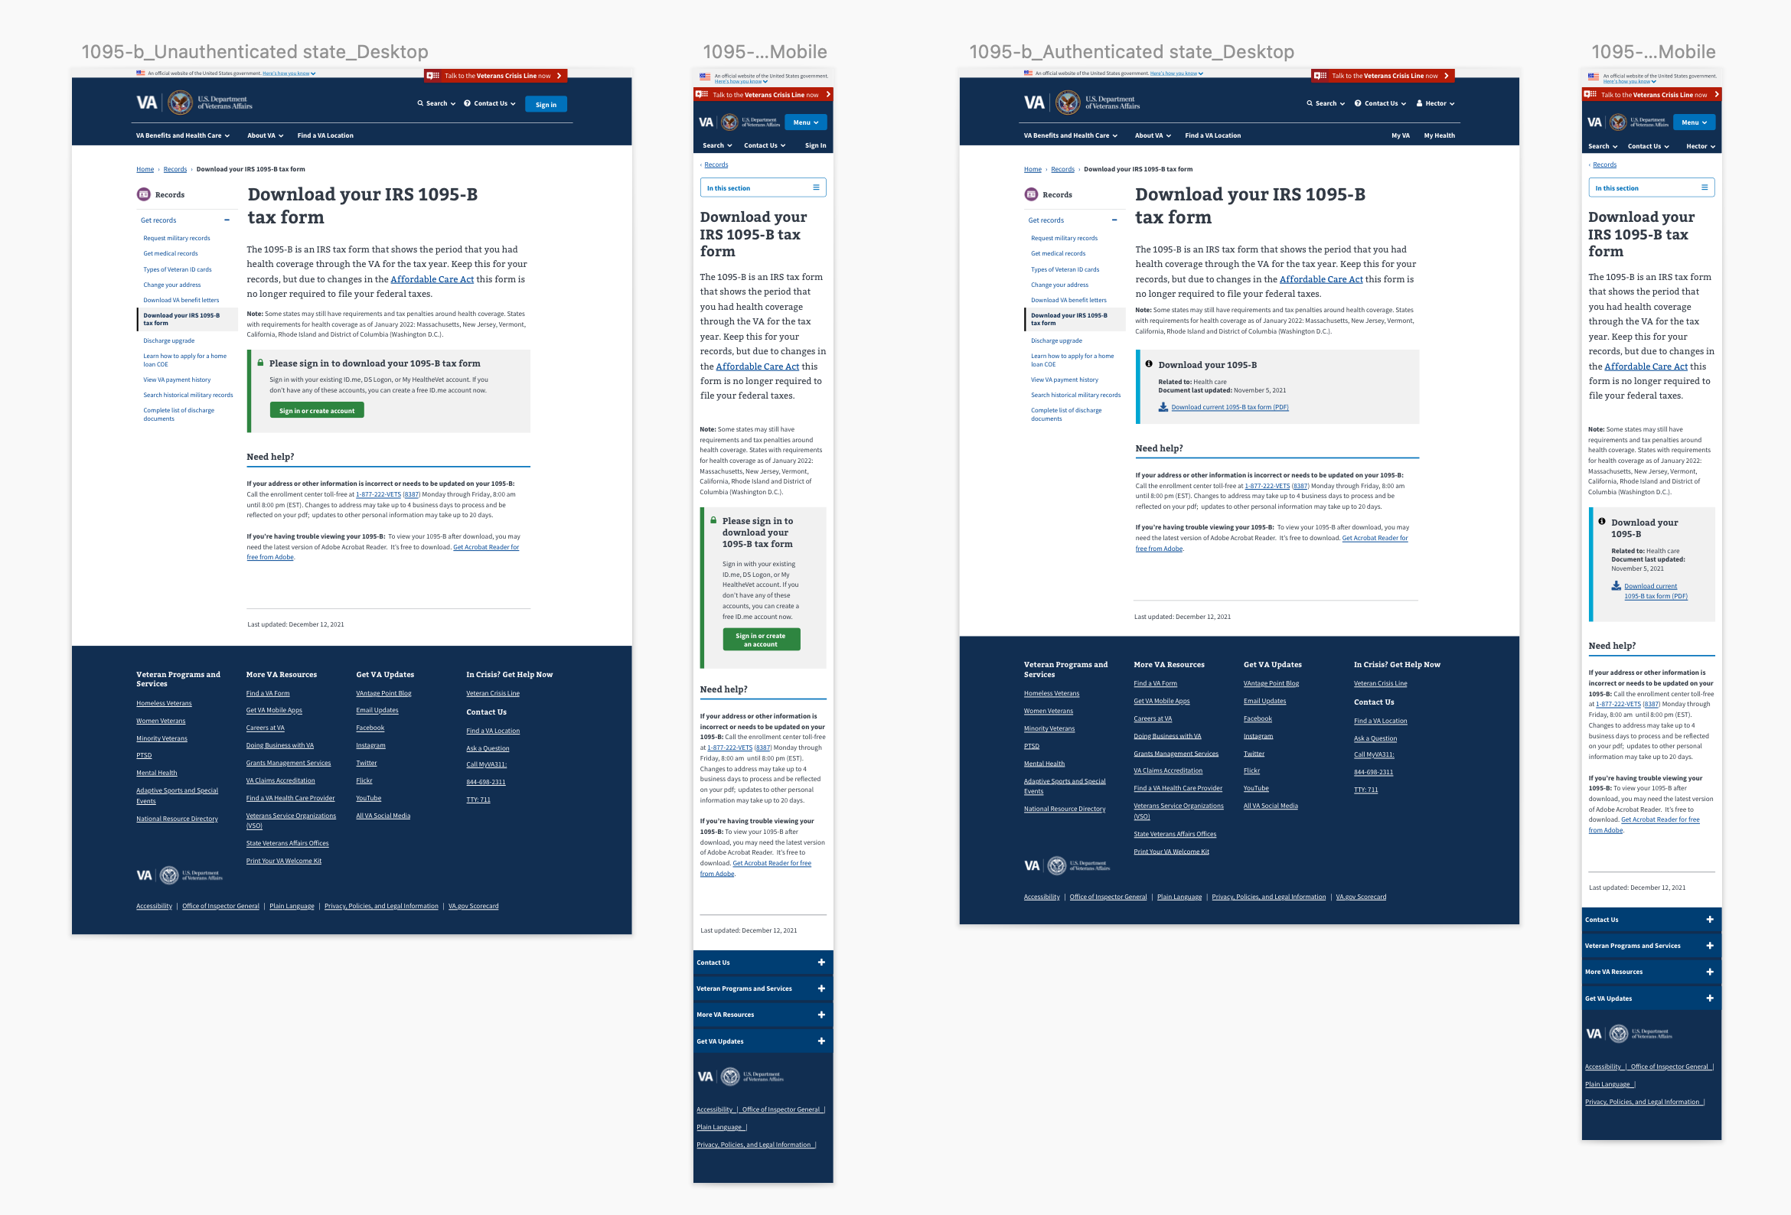
1
DESIGN
We updated our designs to incorporate feedback from Veterans and stakeholders
Unauthenticated
Authenticated
User Story: Finalized content for landing page
User Story: Iterated designs based on VA-PO and research feedback
User Story: Iterate designs based on business owner feedback
User Story: Iterate designs based on collaboration cycle midpoint review
User Story: Update prototype for second round of user testing
Auth (desk, mobile) & Unauth (desk, mobile) Links
03-08 Sprint 3 Demo
Design
19

Slide 20
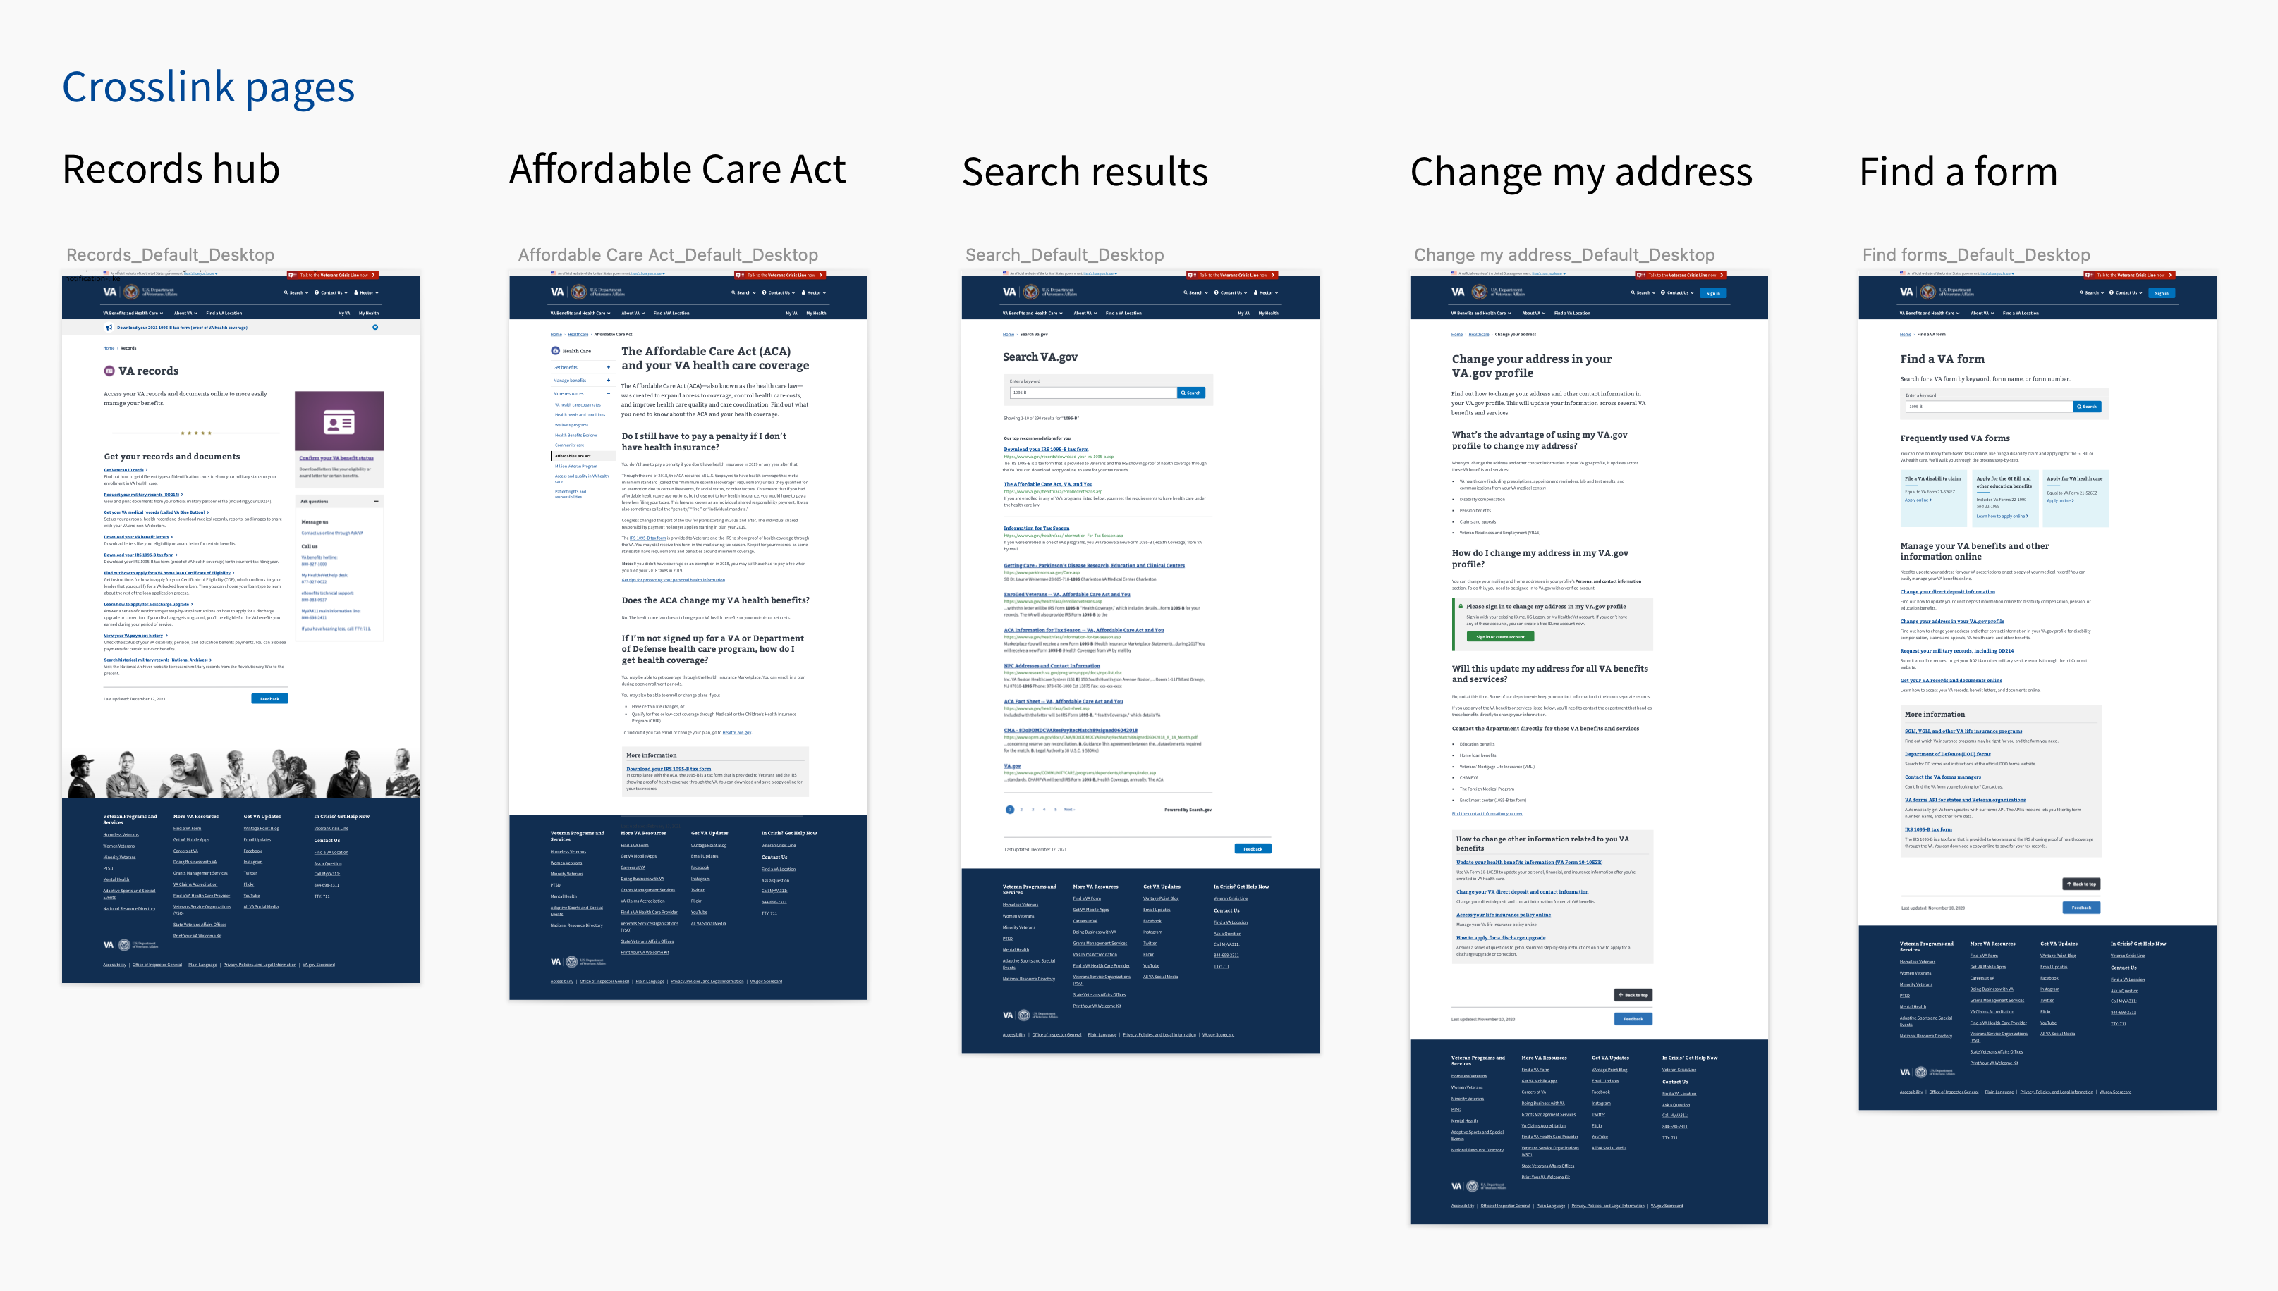
1
DESIGN
We designed additional content needs for way finding
Wayfinding (Change my address, Find a VA form, Records, ACA, Search) Links
03-08 Sprint 3 Demo
Design
20

Slide 21
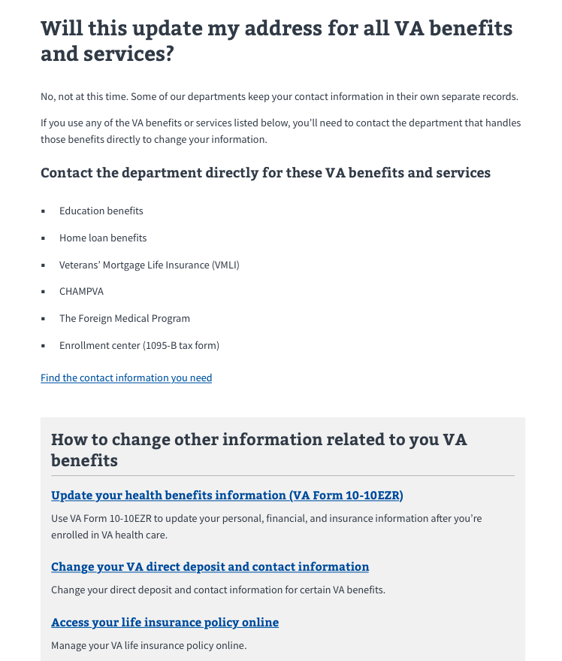
1
DESIGN
We discussed future updates needed for "Change your address"
User testing revealed that some Veterans might navigate to the "Change your address" landing page (via the left rail) to update the address on their 1095-B
Under "Will this update my address for all VA benefits and services," suggest adding the Enrollment Center and 1095-B to the list of departments that you must contact directly to update your address.
Change my address Link
03-08 Sprint 3 Demo
Design
21

Slide 22
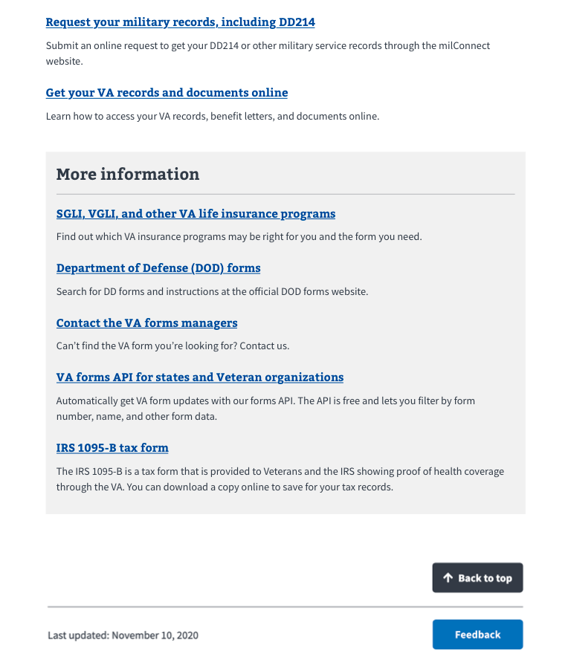
1
DESIGN
We discussed future updates needed for "Find a VA Form"
As the 1095-B is technically an IRS "form," we reasoned that Veterans may use the "Find a VA Form," as a way finding tool to search for this document.
Recommend including a callout for the IRS 1095-B tax form in the "More information" box that currently exists at the bottom of the landing page.
Find a VA form Link
03-08 Sprint 3 Demo
Design
22

Slide 23
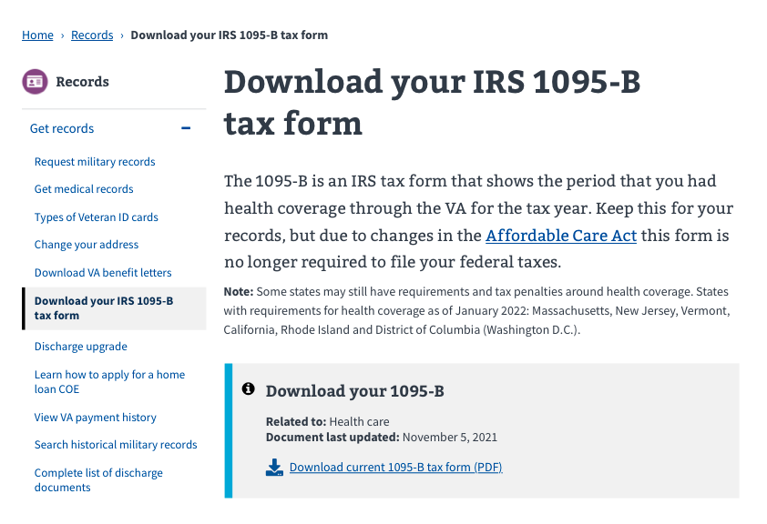
1
DESIGN
We proposed where our 1095-B page would live within VA.gov
User Story: Content & IA Review
Decision from Monday 3/7 EOD:
Header will be: Download your IRS 1095-B tax form
URL will be: www.va.gov/records/download-your-irs-1095-b
Finalized IA
03- Sprint 3 Demo
Design
23

Slide 24
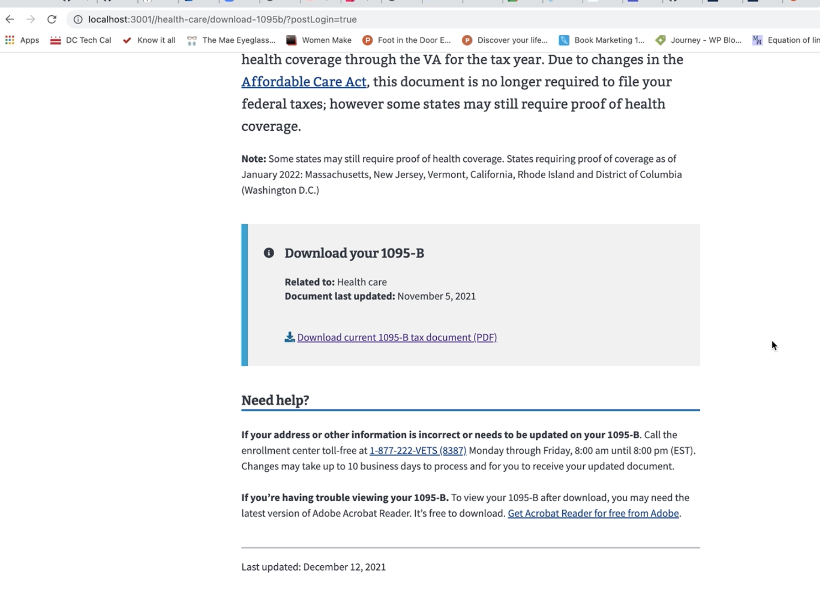
2
TECH
We built out the front end to show a Veteran finding out page, logging in, and being able to download the 1095-B form
User Story: As a veteran, if I’m not logged in, I want to be redirected to log in to be able to download form
User Story: As a veteran, I want to easily understand what the form is, so I know why I need it
User Story: As a veteran, I want to understand what the form is, so I know what to do with it
User Story: As a veteran, I want to ask a question or fix a mistake in my form to avoid issues
User Story: [Enhancement] Update styling of download button to "Exploration" version of wireframe
Video Link in Mural
GitHub Branch
03-08 Sprint 3 Demo
Tech
24

Slide 25
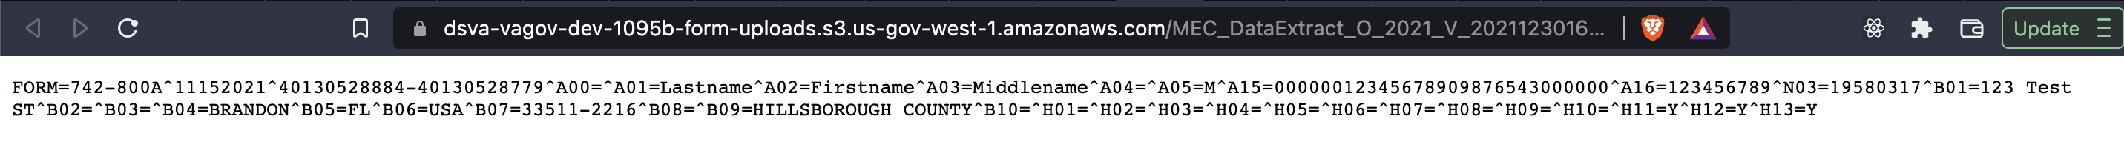
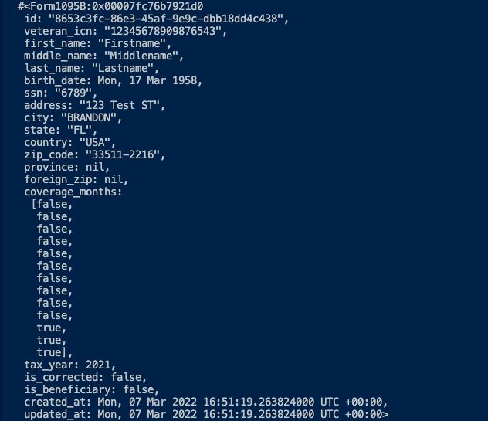
2
TECH
We built out the backend in our test environment of how the data would flow from the enrollment center to be able to create the PDF
User Story: Start to setup controller endpoints
User Story: Provision backend for S3 bucket (or integrate with existing)
User Story: Test PDF generation with test data
User Story: Write POC for the script to get data from flat file to database
Top screenshot is the flat file in the AWS S3 bucket
Right screenshot is the data stored in the Vets-API database after running the script to get above file from S3
GitHub branch
03-08 Sprint 3 Demo
Tech
25

Slide 26
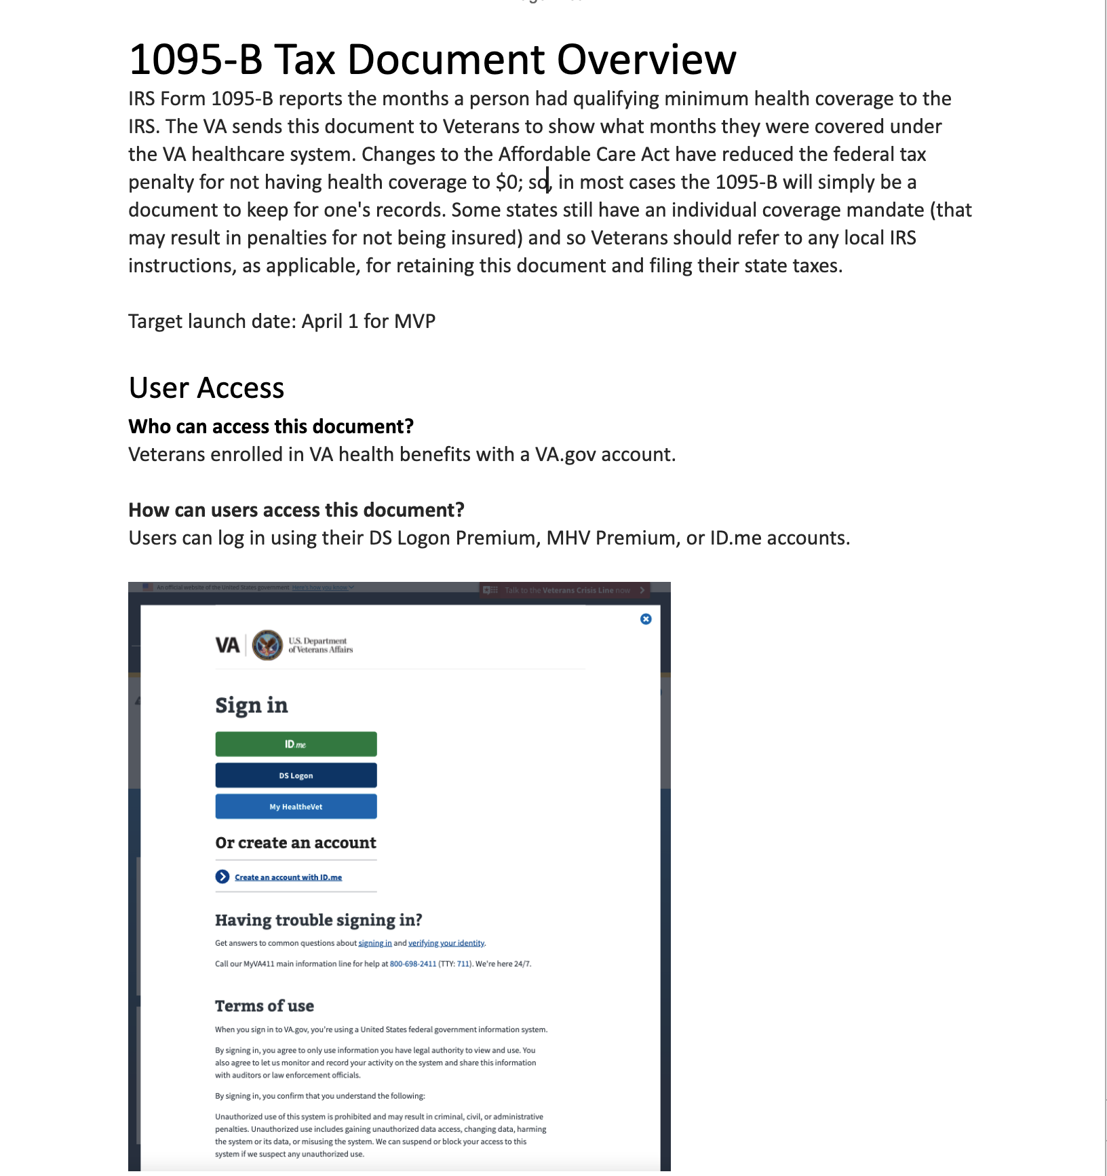
We created materials for the contact center to guide Veterans who call in with questions
3
PRODUCT
User Story: Start product guide for contact center review
The guide includes the following sections:
Overview
Access
Navigation
Functionality
Escalation path
Next steps:
Finalize document with correct URL
Submit for contact center review
Contact center product guide link
03-08 Sprint 3 Demo
Product
26

Slide 27
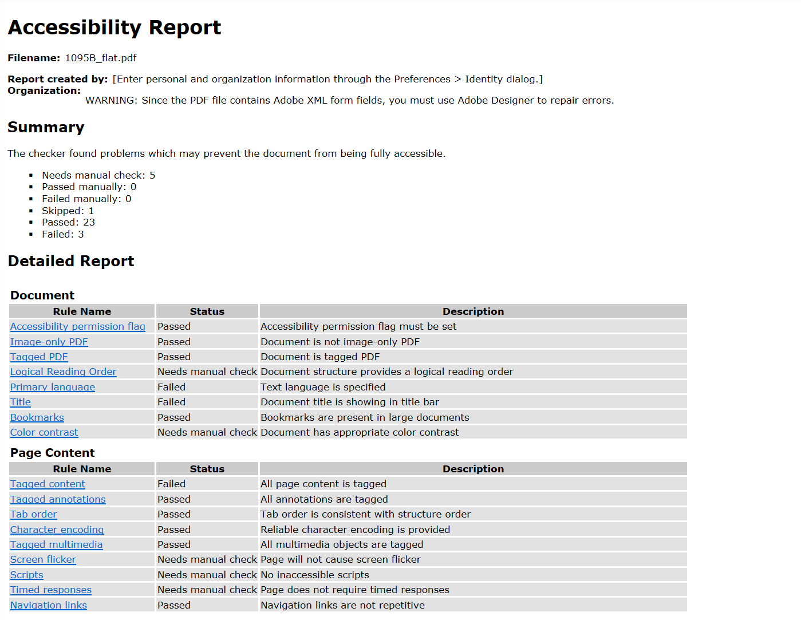
We began the process to validate accessibility of the PDF
3
PRODUCT
User Story: Identify if generated PDF is accessible
Accessibility Test: Adobe Acrobat Professional Accessibility Standards
Documents tested:
PDF generate using dummy data
Original PDF sent by business owner
Results:
For both documents, passed 23 out of 26 tests
Additional review to be done by VA Accessibility Team (Martha Wilkes) for the three tests not passed: Primary Language, Title, Tagged Content
Next steps:
Correct Primary Language setting in Adobe
Confirm if any of these failures are major accessibility blockers for Veterans
Go through full 508 audit post-launch (as part of Collaboration Cycle)
GitHub link
03-08 Sprint 3 Demo
Product
27

Slide 28
We started conversations to align on how a Veteran would be able to opt into paperless digital delivery
3
PRODUCT
The team met with the Profiles team and with our business owner, Tarsha, and we learned:
Profiles team already has plans to build "opt-in" functionality as part of their section of VA.gov
There may be legal requirements where the opt-in needs to be stored directly in the enrollment system
The Profiles team may have access to the enrollment system (to be verified) so that they can record the Veteran's opt-in in a way that the enrollment system can access it
Therefore, Profiles and the enrollment system would need to work together to build opt-in and it would not make sense for us to build opt-in as a one-off feature to live on the 1095-B landing page
Next steps:
Meeting with the Profiles & Enrollment System team on Monday March 14th
03-08 Sprint 3 Demo
Product
28

Slide 29
Sprint 3 Deliverables (1 of 2)
EPIC | STORY | ESTIMATE | ASSIGNED | OUTPUT | REVIEWED WITH VA-PO | SPRINT TEAM GOAL COMPLETED?
Design | #37307 Update prototype for second round of testing | 3 | Grace | Prototype link | 03/04/22 | ✓
Design | #37022 Run second round of user testing and synthesize | 13 | James | Design Review Deck User research synthesis GitHub | 03/04/22 | ✓
Design | #37019 Iterate designs based on VA-PO and research feedback | 3 | Grace | Auth (desk, mobile) & Unauth (desk, mobile) | 03/04/22 | ✓
Design | #37020 Iterate designs based on Business Owner feedback | 2 | Grace | Auth (desk, mobile) & Unauth (desk, mobile) | 03/04/22 | ✓
Design | #36228 Iterate designs based on midpoint review feedback | 5 | Grace | Wayfinding (Change my address, Find a VA form, Records, ACA, Search) Midpoint review ticket | 03/04/22 | ✓
Design | #37023 Finalize content for landing page | 2 | Carl | Prototype link | 03/04/22 | ✓
Tech | #37012 Start to set up controller for endpoints | 5 | Teagan | GitHub Branch | 03/08/22 | ✓
Tech | #37027 Provision backend for S3 bucket (or integrate with existing) | 3 | Teagan | GitHub Branch | 03/08/22 | ✓
Tech | #37030 Test PDF Generation with test data | 5 | Teagan | GitHub Branch | 03/08/22 | ✓
Tech | #37028 Write POC for the script to get data from flat file to database | 8 | Teagan | GitHub Branch | 03/08/22 | ✓
03-08 Sprint 3 Demo
Sprint 3 Deliverables

Slide 30
Sprint 3 Deliverables (2 of 2)
EPIC | STORY | ESTIMATE | ASSIGNED | OUTPUT | REVIEWED WITH VA-PO | SPRINT TEAM GOAL COMPLETED?
Tech | #36447 As a Veteran, if I'm not logged in, I want to be redirected to login to be able to download the form | 2 | Nadya | Video in Mural GitHub Branch | 03/08/22 | ✓
Tech | #36153 As a Veteran, I want to easily understand what this form is so I know why I need it | 1 | Nadya | Video in Mural GitHub Branch | 03/08/22 | ✓
Tech | #35825 As a Veteran, I want to understand what the form is so that I know what to do with it | 1 | Nadya | Video in Mural GitHub Branch | 03/08/22 | ✓
Tech | #35810 As a Veteran, I want to ask a question or fix a mistake in my form to avoid any issues | 1 | Nadya | Video in Mural GitHub Branch | 03/08/22 | ✓
Tech | #37560 [Enhancement] Update styling of download button to "Exploration" version of wireframe | 2 | Nadya | Video in Mural GitHub Branch | 03/08/22 | ✓
Product | #36093 Start the Product Guide for Contact Center review | 3 | Jordan | Contact center product guide link | 03/05/22 | ✓
Product | #37293 Identify if generated PDF is accessible | 5 | Jordan | GitHub Document | 03/06/22 | ✓
03-08 Sprint 3 Demo
Sprint 3 Deliverables

Slide 31
Preview of Sprint 4
SPRINT 3 DEMO

Slide 32
Sprint 4 will run March 9th to March 23rd
New additions to workplan
Owned by design team
Owned by product/ engineering team
Release
SPRINT 0
SPRINT 1
SPRINT 2
SPRINT 3
SPRINT 4
SPRINT 5
Week 1: 01/20 – 01/26
Week 2: 01/26–02/02
Week 3: 02/02 – 02/09
Week 4: 02/09 – 02/16
Week 5: 02/16 – 02/23
Week 6: 02/23 – 03/02
Week 7: 03/02- 03/09
Week 8: 03/09 – 03/16
Week 9: 03/16 – 03/23
Week 10: 03/23 – 03/30
Product & Delivery
Build backlog
Identify Change Management or Communications Plan
Handover plan - Prepare for launch
PIV Onboarding
Prioritized backlog
Immersion & onboarding
Legal Review
User Experience & Design
Immersion & onboarding
Testing prep
Testing prep & recruiting
Create post-MVP design refinements
Voice of Veteran
Voice of Veteran
PIV Onboarding
Wireframes & Design
Design iterations
Design iterations
Design QA
User flows
Engineering & Development
Create tech discovery plan
Data discovery
POC for data flow
Immersion & onboarding
Define data flows - Systems mapping
Build solution (form UI, data connections, storage, etc.)
UAT with Call Center
Test & Refine
Collaboration Cycle
Kickoff
Midpoint Review
Analytics Review
Privacy & Security review
Research Plan Review
Design Intent
Research Plan Review #2 (wireframes)
Staging Review
MVP Launch
Content & IA Review
Contact Center Review
*Does not show post-MVP Validate phase meetings in Collaboration Cycle, such as Full Accessibility Audit and Post-Launch Check In; Contact Center Review adjusted to 3 weeks before launch as approved by Jason Woodman
03-08 Sprint 3 Demo
Preview

Slide 33
Sprint 4 will focus on building out the PDF generation using real data on staging and UAT
1
PRODUCT
Update technical diagram for Security Review
Draft release plan for Security Review
Coordinate remaining collaboration cycle reviews
Investigate with Profiles team and HEC to understand how opt in process may be built
Run UAT with HEC Call Center
Understand what is needed for legal review and impact to timeline
New additions to workplan; dependent on Business Owner
2
DESIGN
Create product video for Contact Center Review
Update product guide and product video based on Contact Center Review feedback
Draft scripts for HEC call center (based on Tarsha’s examples)
Draft design for error state
Conduct design QA of coded designs
Research into VA Notify and how 1095-B might use VA Notify
Start documenting how to run user testing/design workflow (to ease onboarding of next design team)
Iterate wireframe edits from staging review and business owner feedback
Stories subject to change during Sprint planning
3
TECH
Make POC script production ready
As a Veteran, I want to download my form so that my tax records are complete
As a Veteran, I want to quickly navigate to my form once I log in
As a Veteran, I want to easily find the form through Google so that I can find it through my normal methods
Get content widget into production, as part of the front end
As a Veteran, I want my 1095-B document to be accessible (508 compliant)
Make POC script production ready (error handling)
Finish controller (authenticated)
Test authentication with front end and back end
Get PDF Generator working to send back PDF
Make API call on front end (integrate with backend)
Back end and front-end testing
Pushed from Sprint 3; dependent on S3 bucket being provisioned in production
Pushed from Sprint 3; dependent on URL being finalized
 | Next sprint demo: March 22
03-08 Sprint 3 Demo

Slide 34
Appendix
SPRINT 3 DEMO

Slide 35
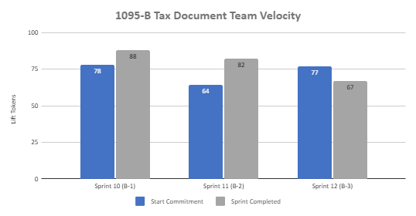
1095-B Sprint team velocity
 | Velocity details Velocity estimated in story points, using Fibonacci Velocity in Sprint 3 accounted for 9 team members 67 total story points were completed; Team committed to 77 story points at beginning of the sprint were completed and completed 65 of the original 77. 12 story points were blocked and unable to be completed due to delays on the VA side; these points were pushed out to Sprint 4 2 story points were added with story brought forward due to new tech capacity 3 story points were for Midpoint Review, which was not a formal deliverable, but accounted for significant prep work that went into Midpoint Review
03-08 Sprint 3 Demo
Appendix
35

Slide 36
Project risks and mitigation strategies
Submitted as part of the Monthly Report on February 7th
RISK AND IMPACT | MITIGATION STRATEGY | DATE |  | STATUS | NOTES
 |  | ENTERED | CLOSED
IRS stakeholder is outside of VA ecosystem. Building without guidance or legal review regarding compliance with IRS regulation could result in risk. | Conduct research on available information surrounding current IRS 1095-B tax form regulations. Seek legal review through VA resources as directed by VA-PO and Business Owner | 1/20/22 | 2/11/22 |  | VA Business Owner clarified that IRS review is not needed
Team had previously confirmed with Business Owner that legal review was not needed. Business Owner clarified that legal review would be needed as of March 2nd | Business Owner is seeking a POC with the Office of General Counsel to understand what is needed and potential launch impact | 3/2/22
Data requires storage in a S3 bucket that the enrollment system can have access to in production; process to create the staging and production bucket does not have a clear timeline. Without the S3 bucket in prod with enrollment system access, product cannot be built in prod | Daily follow-ups with Jesse House and Mike Chelan (infrastructure team) | 3/1/22
Business owner raised User Acceptance Testing should be done with HEC Call Center | Requested Business Owner to schedule UAT with required individuals for mid-March and book as early as possible | 3/2/22
Feedback from Content and IA Review has taken over a week to come in; feedback is changing our proposal for the H1 and delaying confirmation of where the 1095-B landing page should live, which in turn delays our ability to complete the front end (top nav and side nav bars) | Design team pushing on IA team to confirm final answer of where 1095-B landing page should live and what the H1 header title should be | 03/04/22 | 3/8/22 |  | URL confirmed 3/7 EOD; IA review now closed
03-08 Sprint 3 Demo
Appendix
36

